Slide 1


UNIT 4: Clocks and calendars
Emily’s timetable

Slide 2

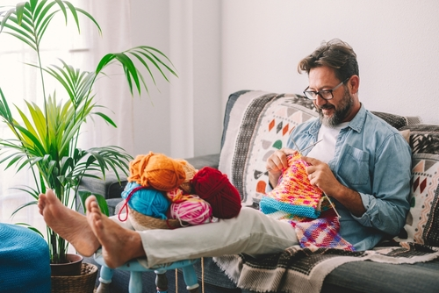
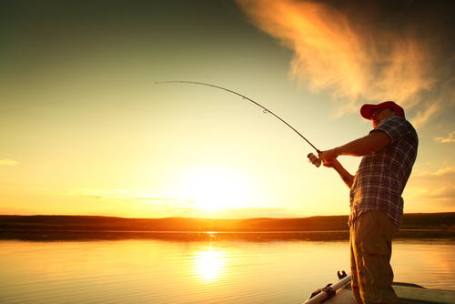
Learn more: Hobbies of celebrities.
https://www.e-sfera.hr/dodatni-digitalni-sadrzaji/cc5b643a-1e68-4781-b69f-49cba52c6244/
What’s your hobby?

Slide 3
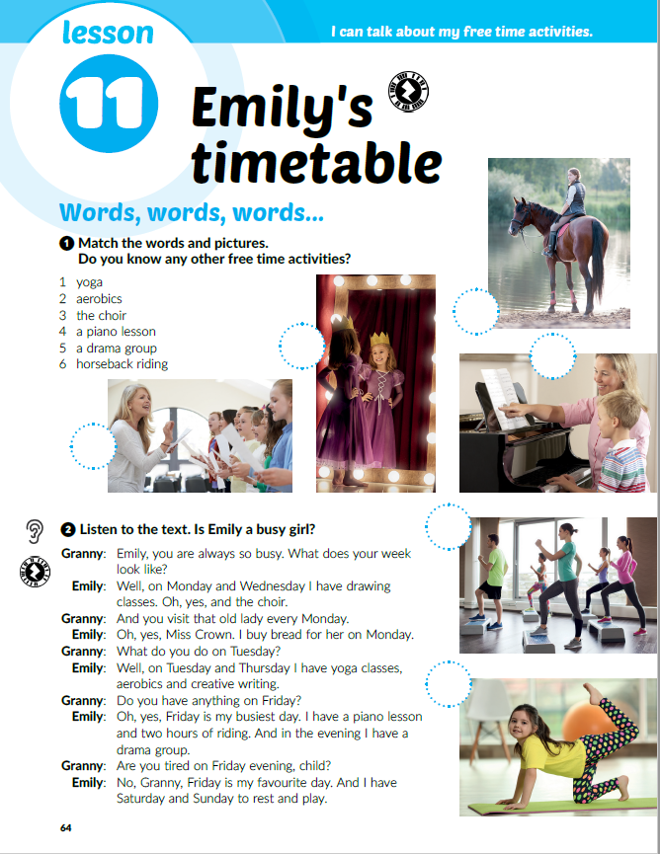

Translate:
busy =
drawing =
creative writing =
riding =
6
zaposlen
5
4
crtanje
kreativno pisanje
3
jahanje
2
Listen and answer the question:
Is Emily a busy girl?
1
Listen again. Which preposition do we use with the days of the week?
ON

Slide 4
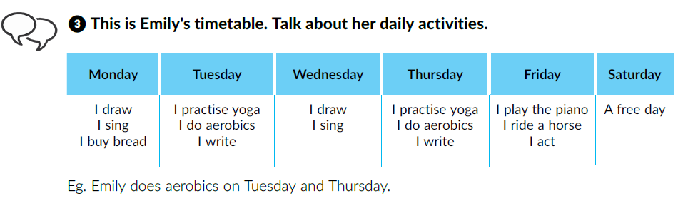
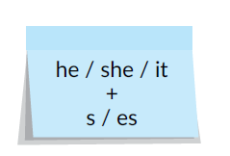
Talk about Emily’s daily activities.
We use the Present Simple to talk about daily activities.
We add the suffix –s or –es in the 3rd person singular (he / she / it).

Slide 5
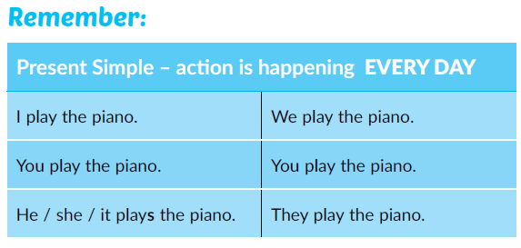
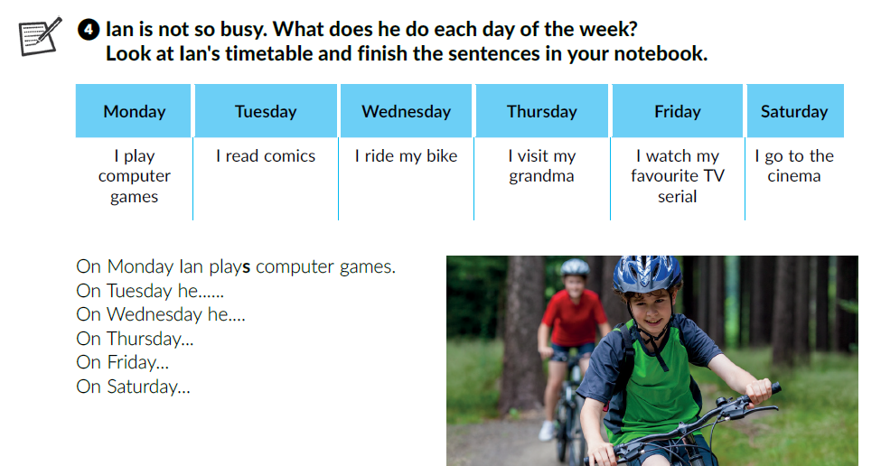
The difference between the Present Simple and the Present Continuous
Finish the sentences. You can write the suffix –s / -es in a different colour.
reads comics
rides his bike.
he visits his grandma.
he watches his …
he goes to the cinema.

Slide 6
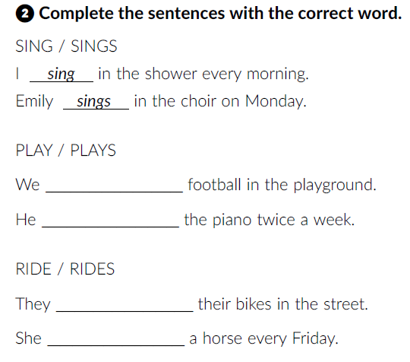
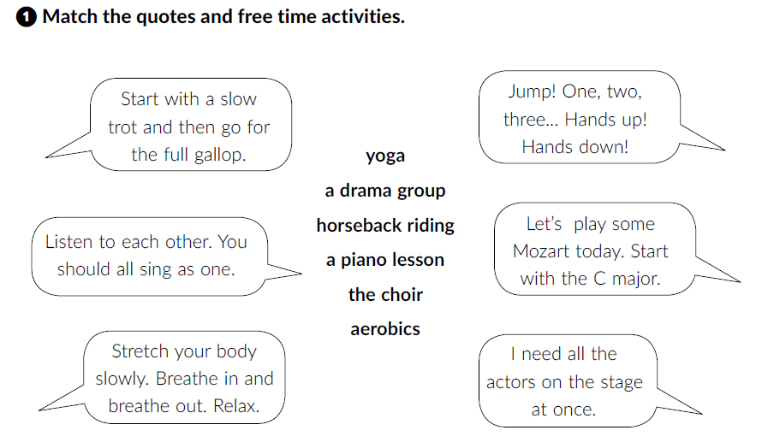
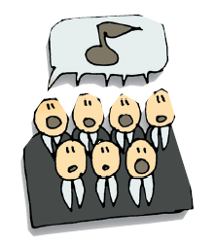
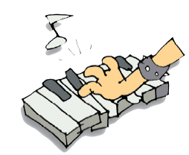
Workbook, p. 43, 44
horseback riding
aerobics
play
plays
the choir
a piano lesson
ride
yoga
a drama group
rides

Slide 7
Learn more: Too many interesting things to do.
https://www.e-sfera.hr/dodatni-digitalni-sadrzaji/9cb21d2e-d3ed-4861-b209-42b3cd8c9ce1/
Read the text. What is Filip’s problem?
Read the text again. Make Filip’s timetable. You can work in pairs if you want.
Write him a letter and give some advice.
Make a timetable of your weekly activities in your notebook.
Swap your notebook with a classmate. He/She uses your timetable and talks about your week.

Slide 8
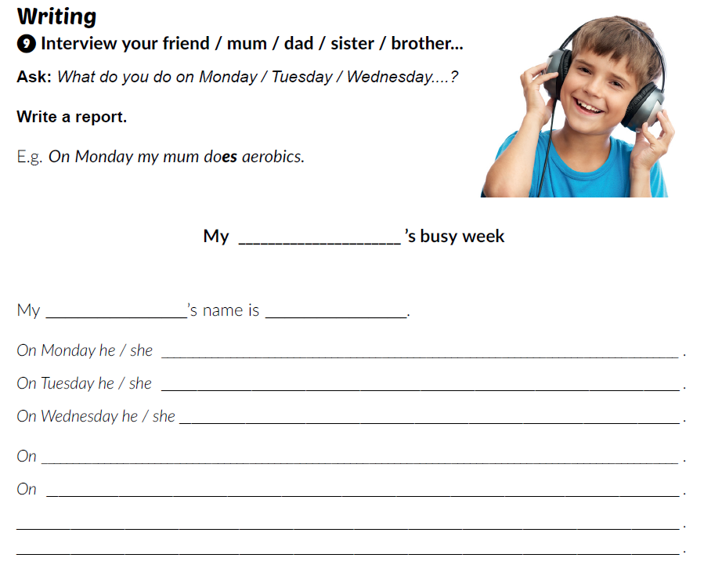
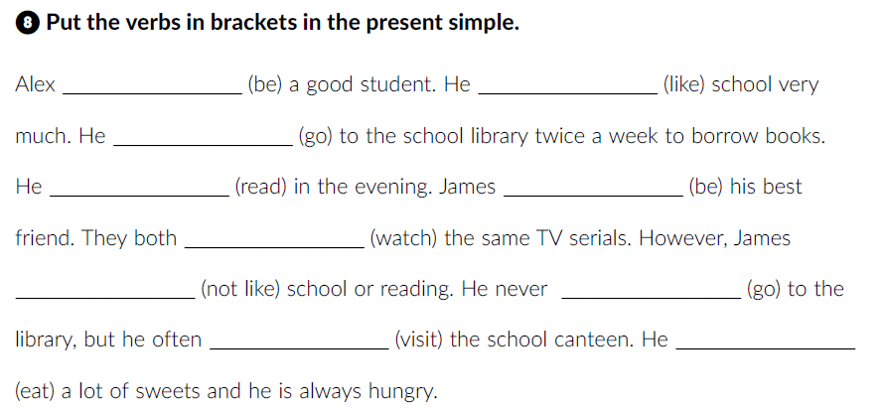
Workbook, p. 46.
is
likes
goes
reads
is
watch
doesn’t like
goes
visits
eats

Slide 9
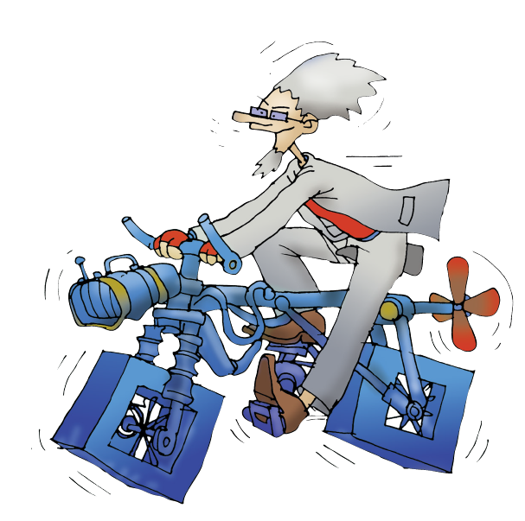
What are your favourite toys?
What does Dr Project look like?
Is he a bit unusual?
Why?

Slide 10
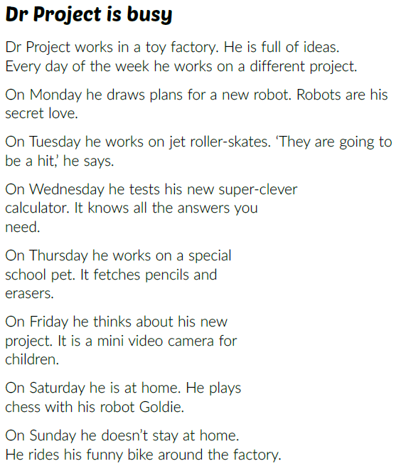
Listen and underline all the gadgets mentioned.

Slide 11
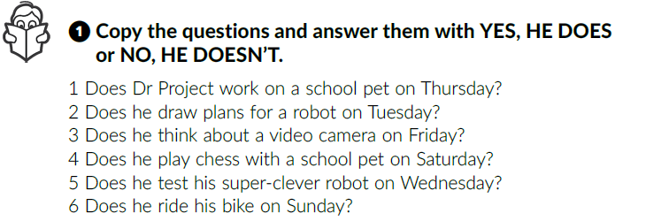
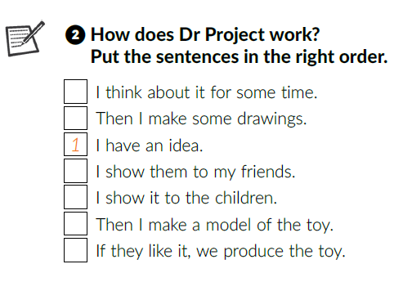
Listen again and answer the questions.
Yes, he does.
No, he doesn’t.
Yes, he does.
No, he doesn’t.
No, he doesn’t.
Yes, he does.
2
3
4
6
5
7

Slide 12
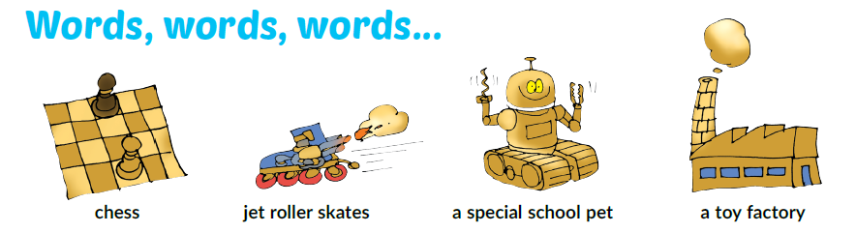
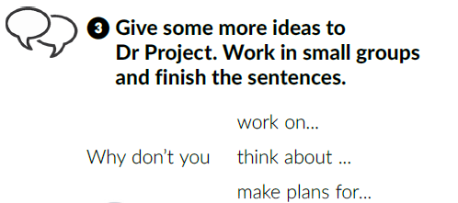
Work in groups.
Present your new gadget or toy to the rest of the class.

Slide 13
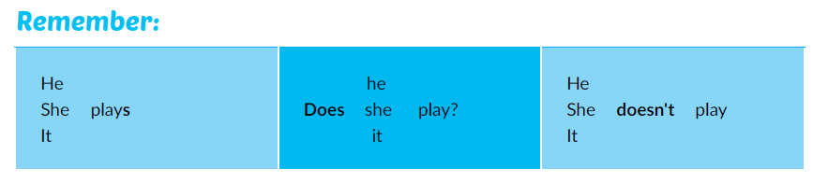
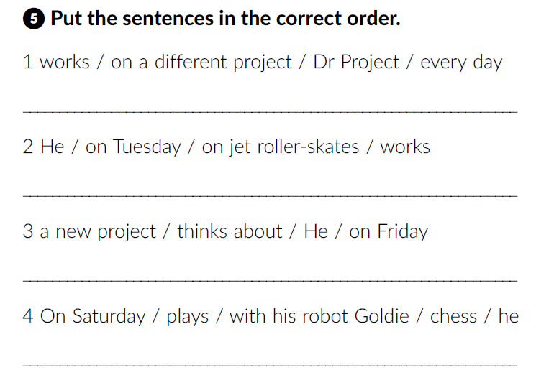
Workbook, p. 45
Dr Project works on a different project every day.
He works on a jet roller-skates on Tuesday.
He thinks about a new project on Friday.
On Saturday he plays with his robot Goldie.

Slide 14
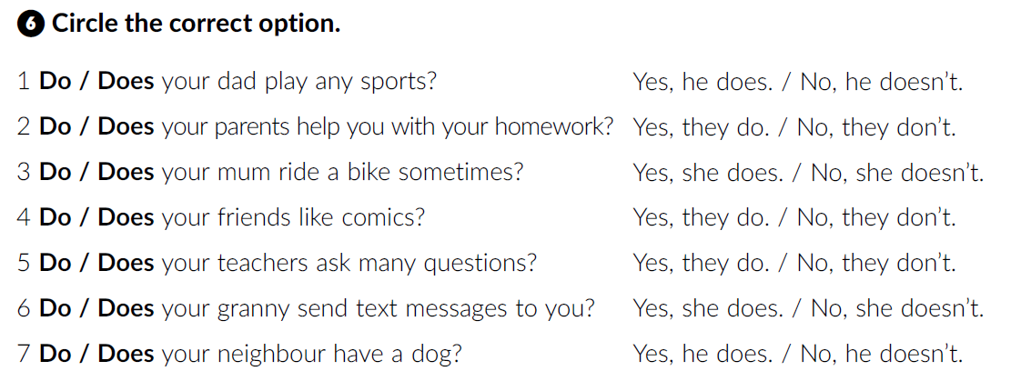
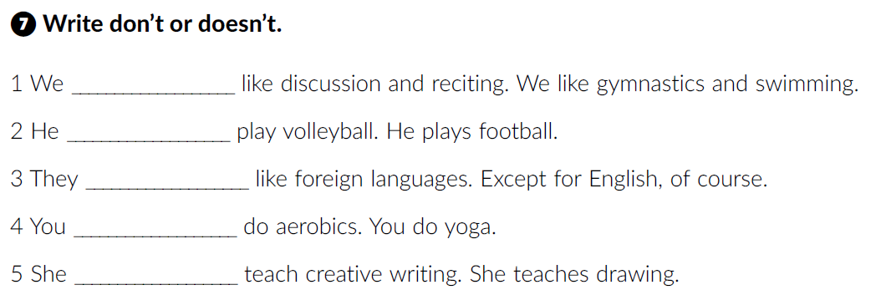
don’t
doesn’t
don’t
don’t
doesn’t

Slide 15
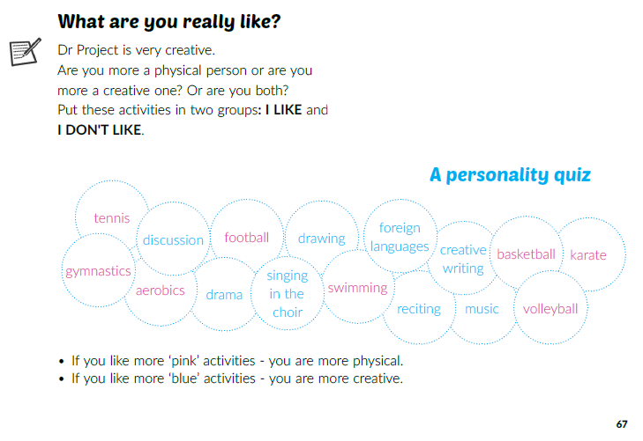
Do a personality quiz.
Do you agree with the result? Why (not)?

Slide 16
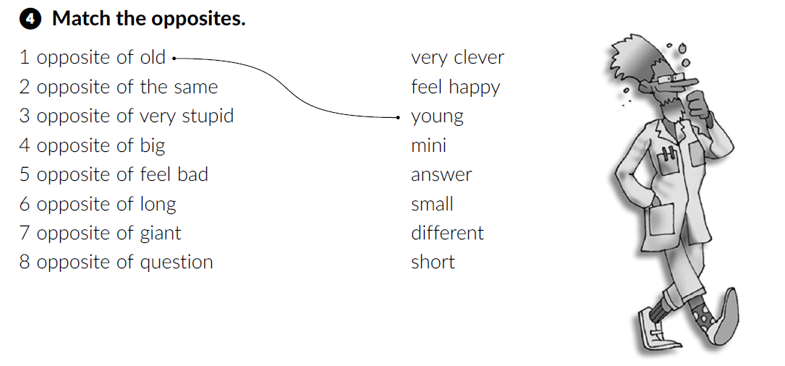
Open your workbook at page 44.
different
Click on the following link and choose Self check. Complete the tasks.
https://www.e-sfera.hr/dodatni-digitalni-sadrzaji/cc5b643a-1e68-4781-b69f-49cba52c6244/
very clever
small
feel happy
short
mini
answer

